Slide 1

Prediction of average temperature and humidity of Austin/Texas weather based on time series analysis

Slide 2
Abstract
-CSV file regarding weather condition of Austin/ Texas
-Creating data frame
-Data Cleaning
-Visualization and analysis
-Modelling and performance evaluation based on Bayesian Information Criterion (BIC)
-Prediction

Slide 3

Data Cleaning
-Checking all null values
-Removing all of meaningless signs
-Filling null values by interpolation
-Filling the blanks of 'Events' column by appropriate value

Slide 4
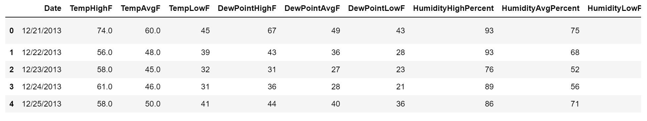
Initial CSV file and data frame
1319 rows and 21 columns

Slide 5
Steps of data cleaning
Checking the null values and meaningless signs
Filling the null and meaningless values by interpolation
Checking the blanks in the column of 'Events'
Filling the blanks of this column by appropriate phrases
Setting the date to time index for the data table
So after cleaning and setting timestamp, the dataset has 20 columns.

Slide 6

Data visualization and analysis
Some graphs for the data frame have been illustrated.
Some statistical analysis have been performed

Slide 7
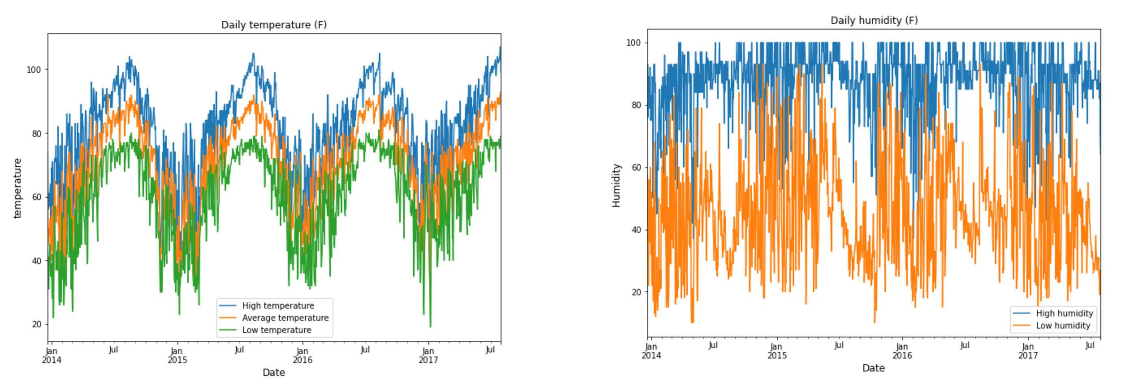

Slide 8
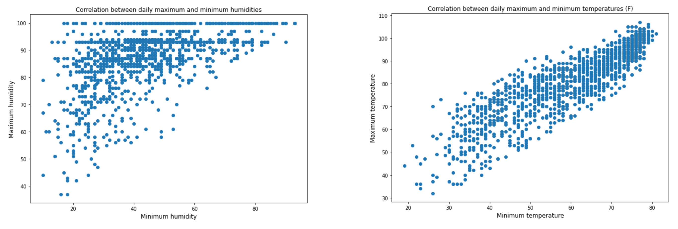

Slide 9
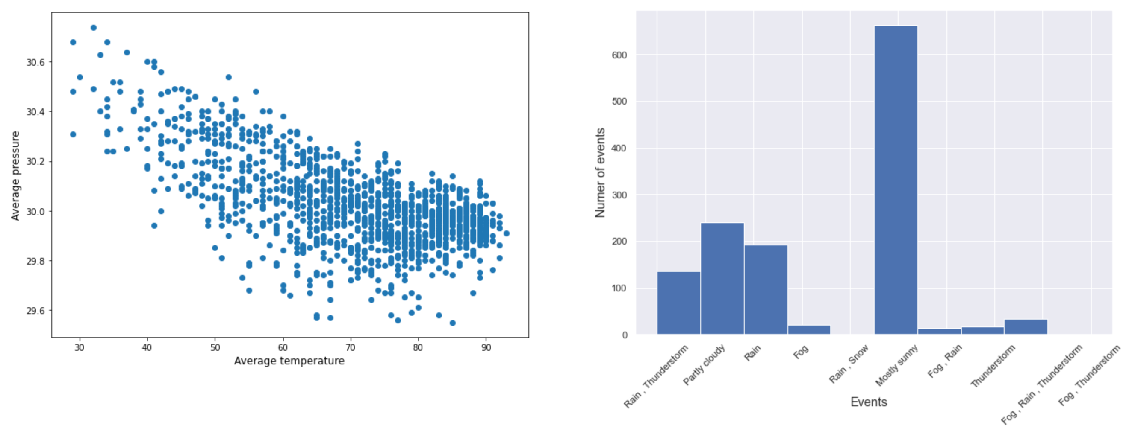
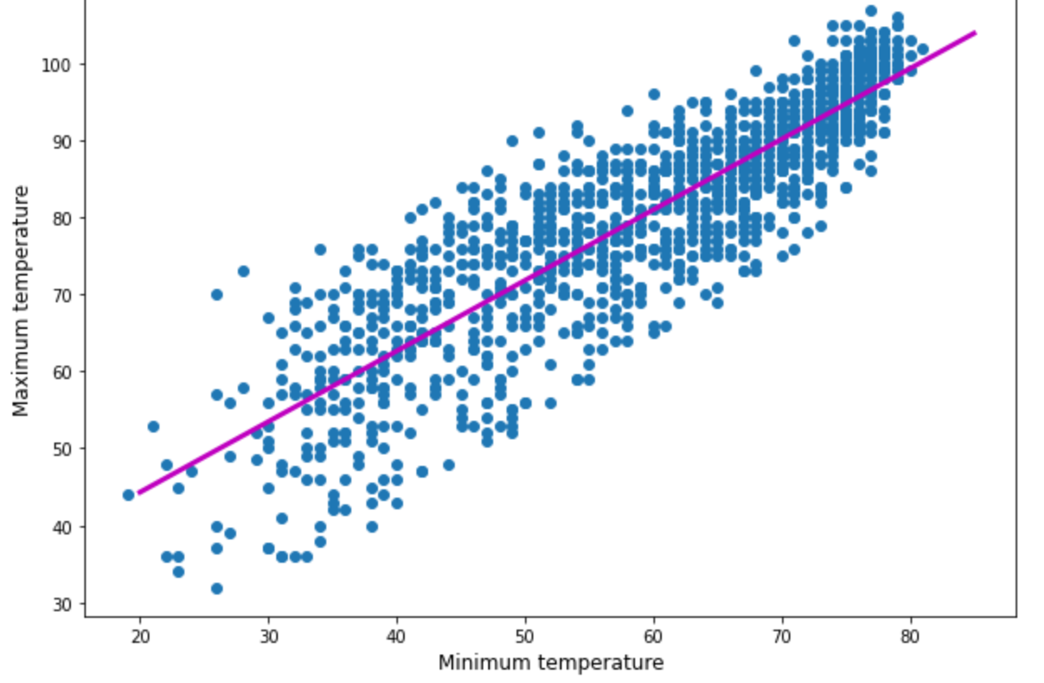
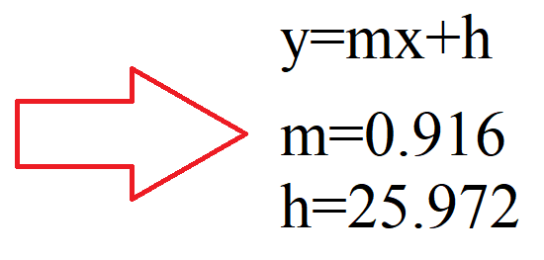

Slide 10

Graphs justification
The trends of maximum-minimum temperatures and maximum-minimum humidities are ascending although there are some outliers on the graphs
The trend for average pressure and temperature is descending
The most frequent weather status of Austin/Texas are: Mostly sunny, partly cloudy, rain and rain-thunderstorm
The highest maximum temperature takes place at 2017-07-29 which is 107° F
The lowest minimum temperature happens at 2017-01-07 that is 19° F

Slide 11

Machine Learning
Two types of modelling have been applied:
-Forecasting by single feature
-Prediction by multiple features
Note: According to the KPSS method, both series are stationary, so it is possible to start modelling

Slide 12
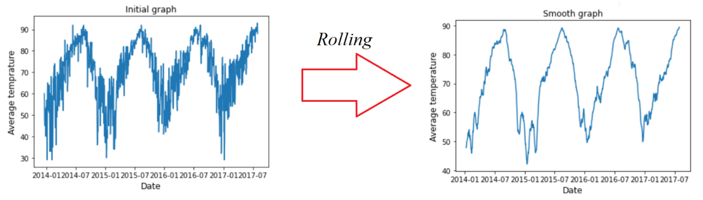
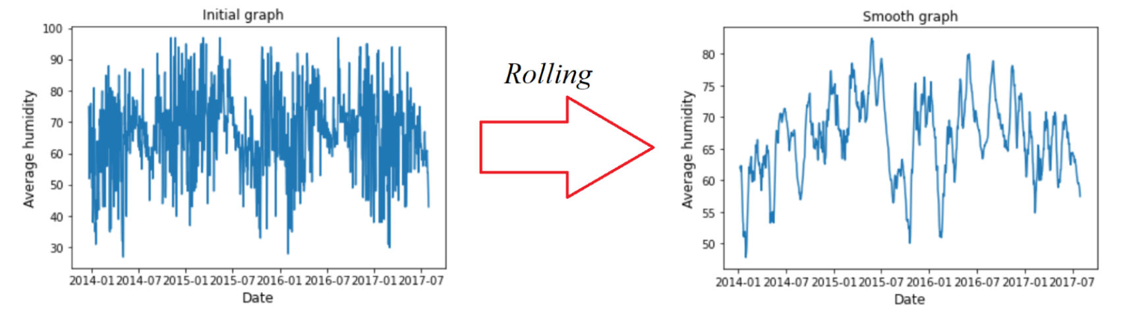
Smoothing the curves (Rolling):

Slide 13
Models using single feature: Bayesian Information Criterion (BIC) is employed to observe the model performance
AR (Auto Regressive):
Model=ARMA(p,0) --> AR model
Based on BIC value, second order (p=2) for the function is valid for temperature and humidity

Slide 14
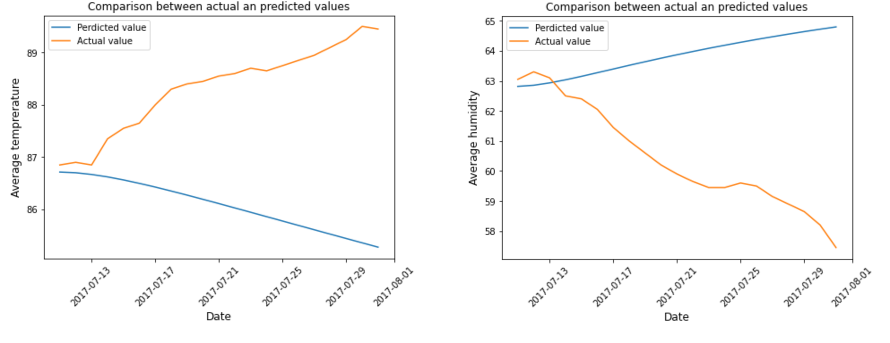

Slide 15
MA model (Moving average):
Model=ARMA(0,q) --> MA model
According to the performance evaluation, q>1 the function has divergence. So we have to get the results with q=1.

Slide 16
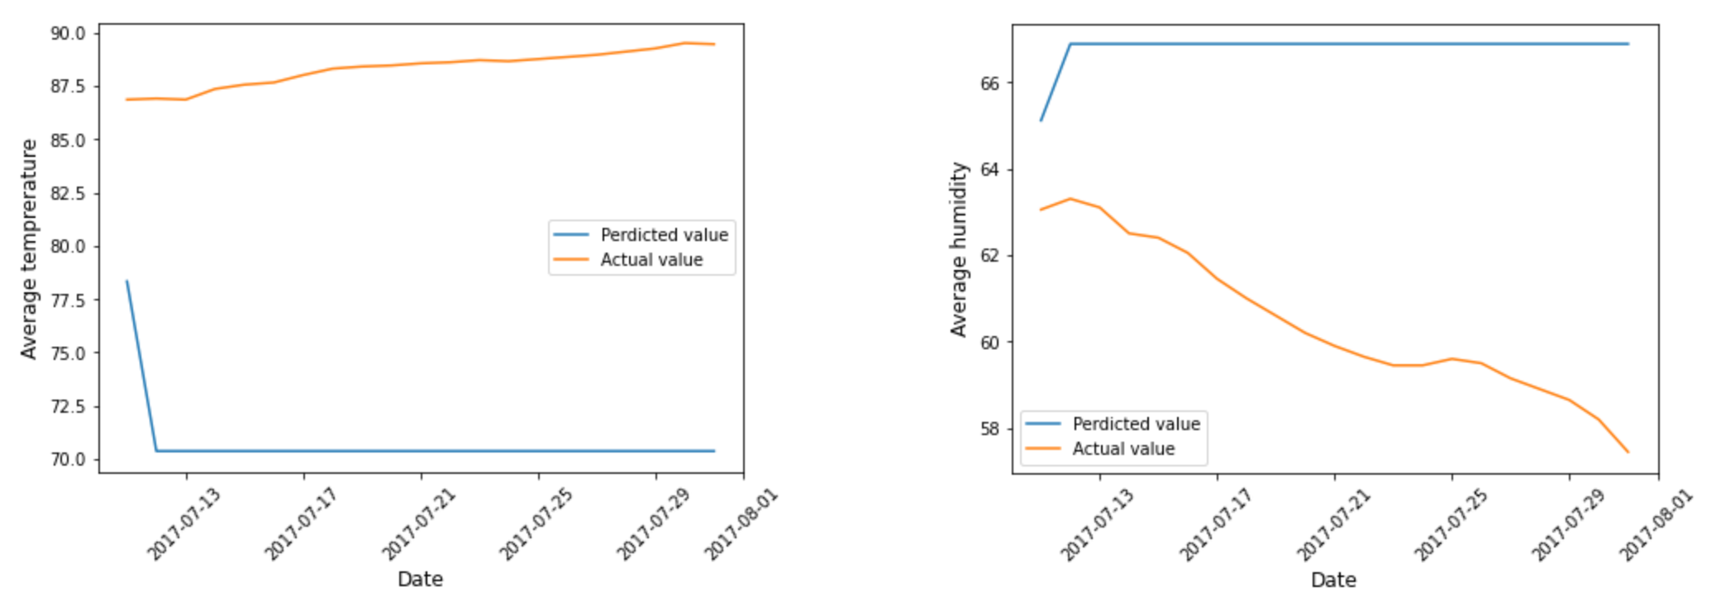

Slide 17
ARMA model:
Model=ARMA(p,q) --> ARMA model
P=2, q=3 : Temperature
P=4, q=4 : Humidity

Slide 18
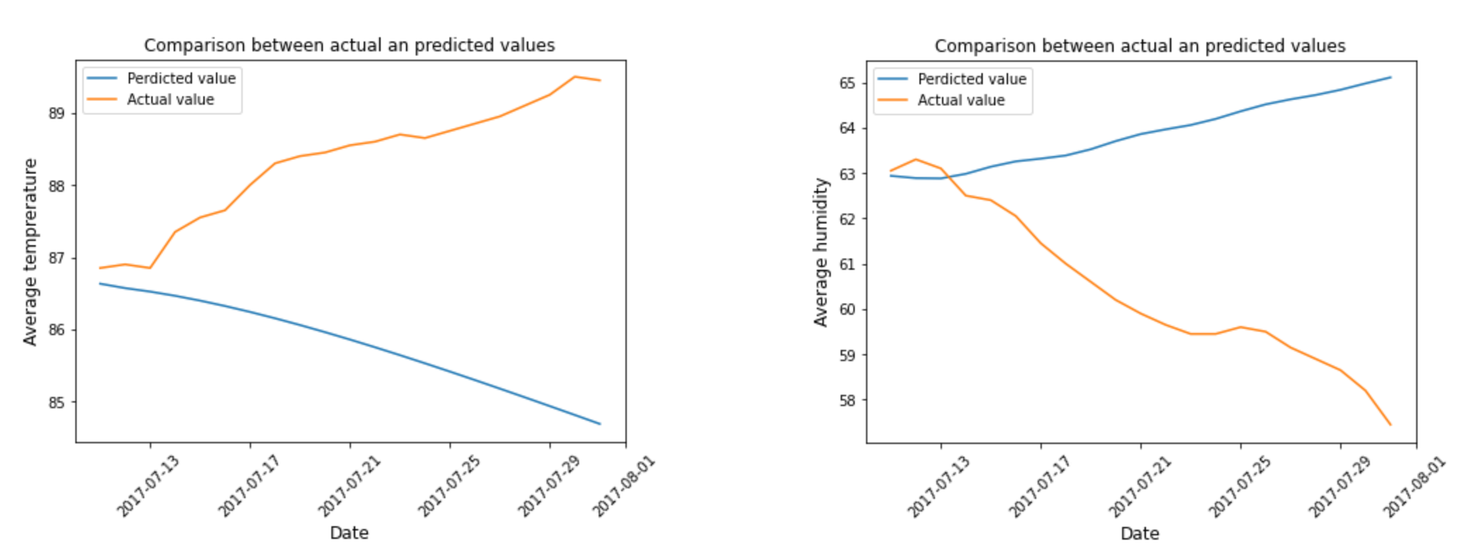

Slide 19
ARIMA:
Model=ARIMA(p,d,q)
P=5, d=1, q=5 : Temperature
P=6, d=1, q=7 : Humidity

Slide 20
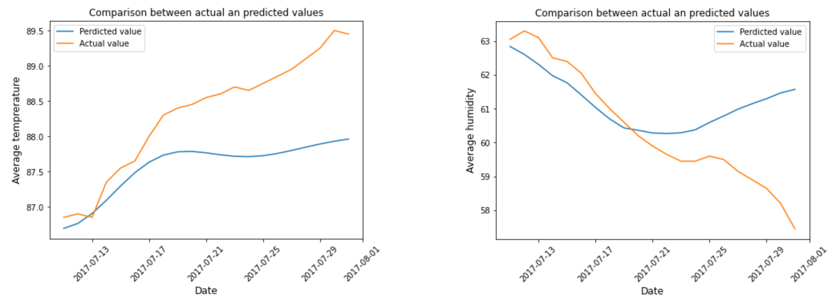

Slide 21
Modelling with multiple features
LinearRegression function which utilize multiple features is applied for prediction.
The dataset has categorical variables and they should be converted to dummy variables by get_dummy method. So there are 29 columns after getting dummy variables.
Here is the function:
model=LinearRegression()

Slide 22
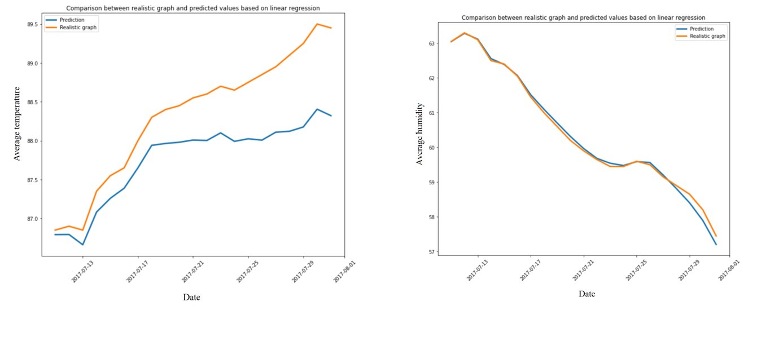

Slide 23
Conclusion
The trend between daily maximum and minimum temperatures is ascending
The correlation for average pressure and temperature is descending
Most frequent events related to weather status are mostly sunny, partly cloudy, rain and thunderstorm-rain
ARIMA model is more precise rather than other three functions using single feature
LinearRegression model has the best results, because it is using multiple features

Slide 24

Thank you

